Slide 1

Business School
Self-assembling insurance claim models
Greg Taylor
School of Risk and Actuarial Studies, UNSW Australia
Sydney, Australia
Hugh Miller
Gráinne McGuire
Taylor Fry Analytics & Actuarial Consulting, Sydney, Australia
2nd International Congress on Actuarial Science and Quantitative Finance
Cartagena, Colombia, June 15-18, 2016.

Slide 2
Overview
Motivation
Regularized regression
  In general
  The lasso
Loss reserving framework and notation
Application of lasso to loss reserving
Test on simulated data
  Data set
  Results
Further testing and development
Conclusion

Slide 3
Motivation (1)
Consider loss reserving on the basis of a conventional triangular data set
  e.g. paid losses, incurred losses, etc.
A model often used is the chain ladder
  This involves a very simple model structure
  It will be inadequate for the capture of certain claim data characteristics from the real world (illustrated later)

Slide 4
Motivation (2)
When such features are present, they may be modelled by means of a Generalized Linear Model (GLM) (McGuire, 2007; Taylor & McGuire, 2004, 2016)
But construction of this type of model requires many hours (perhaps a week) of a highly skilled analyst
  Time-consuming
  Expensive
Objective is to consider more automated modelling that produces a similar GLM but at much less time and expense

Slide 5
Overview
Motivation
Regularized regression
  In general
  The lasso
Loss reserving framework and notation
Application of lasso to loss reserving
Test on simulated data
  Data set
  Results
Further testing and development
Conclusion

Slide 6

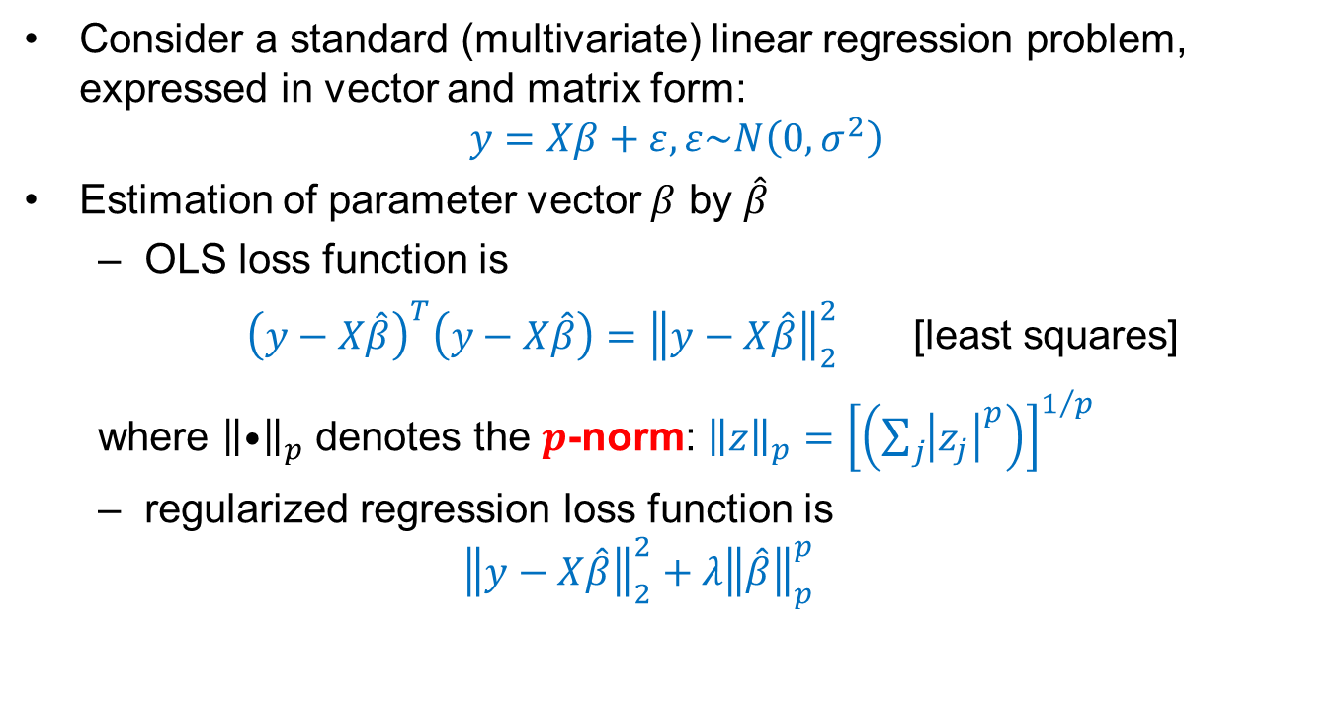
Regularized regression: in general
Consider a standard (multivariate) linear regression problem, expressed in vector and matrix form:
$$y=Xβ+ε,ε\sim N\left(0,σ^{2}\right)$$
Estimation of parameter vector $β$ by $\hat{β}$
  OLS loss function is
  ${\left(y−X\hat{β}\right)}^{T}\left(y−X\hat{β}\right)={\left\|y−X\hat{β}\right\|}_{2}^{2}$ [least squares]
  where ${\left\|•\right\|}_{p}$ denotes the $p$-norm: ${\left\|z\right\|}_{p}={\left[\left(\sum_{j}{{\left|z_{j}\right|}^{p}}\right)\right]}^{1/p}$
  regularized regression loss function is
  $${\left\|y−X\hat{β}\right\|}_{2}^{2}+λ{\left\|\hat{β}\right\|}_{p}^{p}$$
Penalty for poor fit
Tuning constant (𝜆$≥0$)
Penalty for additional parameters

Slide 7
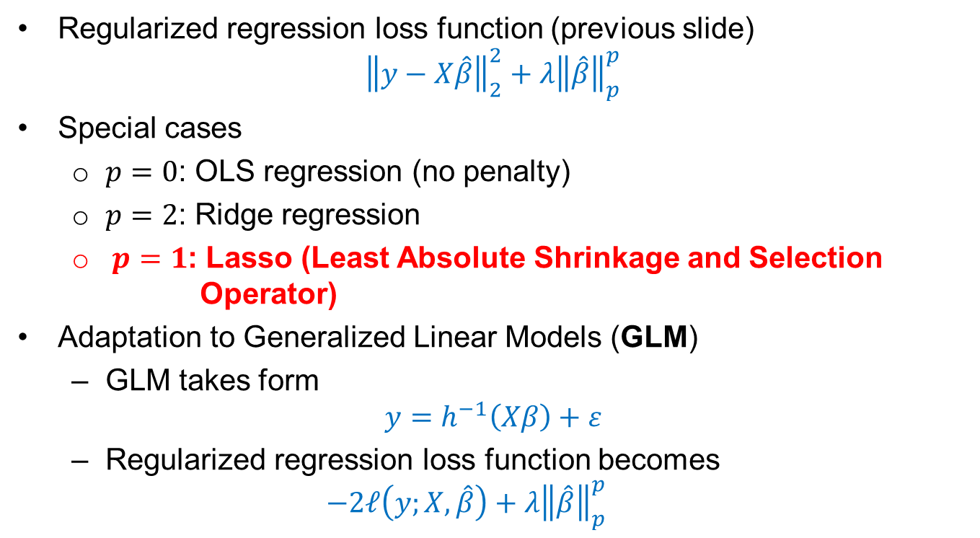
Regularized regression: the lasso
Regularized regression loss function (previous slide)
  $${\left\|y−X\hat{β}\right\|}_{2}^{2}+λ{\left\|\hat{β}\right\|}_{p}^{p}$$
Special cases
  $p=0$: OLS regression (no penalty)
  $p=2$: Ridge regression
  $p=1$: Lasso (Least Absolute Shrinkage and Selection Operator)
Adaptation to Generalized Linear Models (GLM)
  GLM takes form
  $$y=h^{−1}\left(Xβ\right)+ε$$
  Regularized regression loss function becomes
  $$−2ℓ\left(y;X,\hat{β}\right)+λ{\left\|\hat{β}\right\|}_{p}^{p}$$
Link function
Stochastic error (EDF)
Log-likelihood

Slide 8
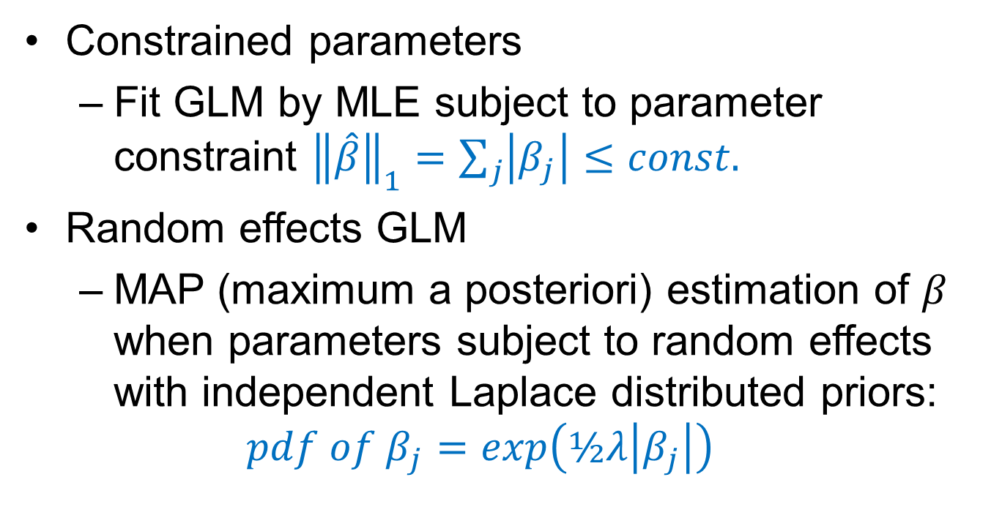
Formal derivations of the GLM lasso
Constrained parameters
  Fit GLM by MLE subject to parameter constraint ${\left\|\hat{β}\right\|}_{1}=\sum_{j}{\left|β_{j}\right|}≤const.$
Random effects GLM
  MAP (maximum a posteriori) estimation of $β$ when parameters subject to random effects with independent Laplace distributed priors:
  $$pdf of β_{j}=exp\left(½λ\left|β_{j}\right|\right)$$

Slide 9
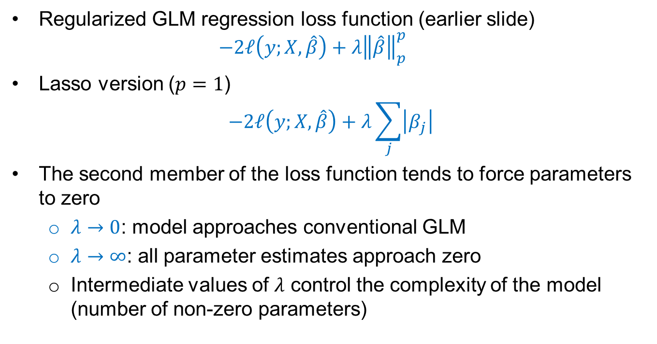
Application of GLM lasso
Regularized GLM regression loss function (earlier slide)
  $$−2ℓ\left(y;X,\hat{β}\right)+λ{\left\|\hat{β}\right\|}_{p}^{p}$$
Lasso version ($p=1$)
  $$−2ℓ\left(y;X,\hat{β}\right)+λ\sum_{j}{\left|β_{j}\right|}$$
The second member of the loss function tends to force parameters to zero
  $λ→0$: model approaches conventional GLM
  $λ→∞$: all parameter estimates approach zero
  Intermediate values of $λ$ control the complexity of the model (number of non-zero parameters)

Slide 10
Overview
Motivation
Regularized regression
  In general
  The lasso
Loss reserving framework and notation
Application of lasso to loss reserving
Test on simulated data
  Data set
  Results
Further testing and development
Conclusion

Slide 11
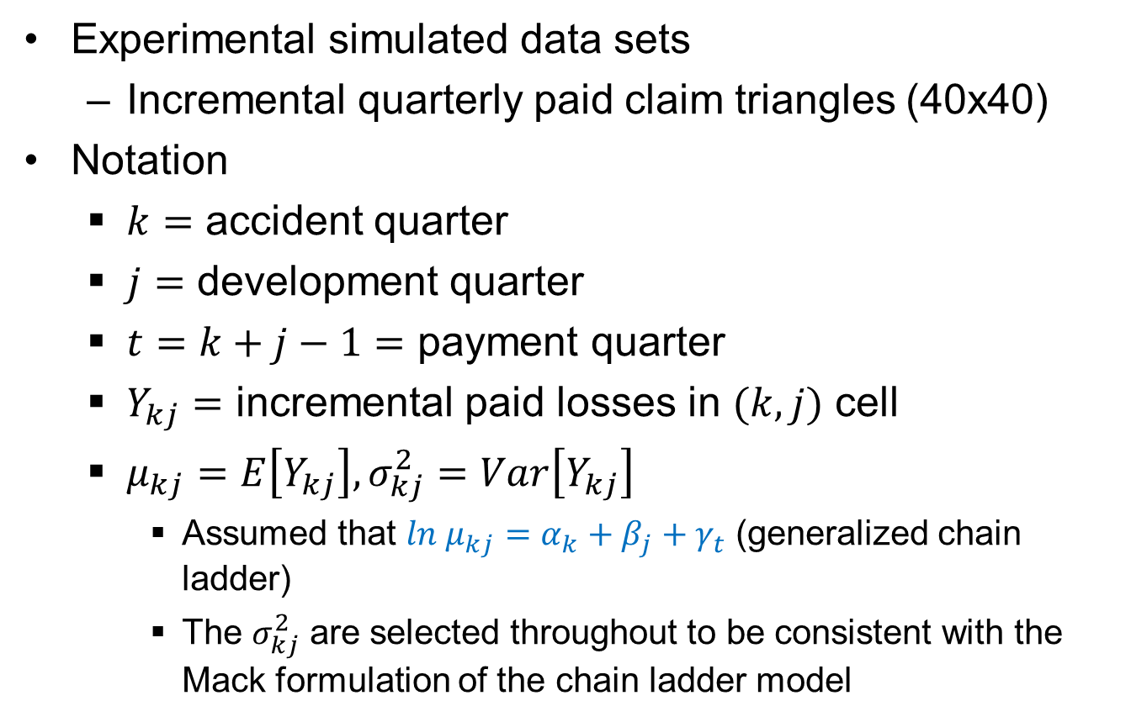
Loss reserving framework and notation (1)
Experimental simulated data sets
  Incremental quarterly paid claim triangles (40x40)
Notation
  $k=$ accident quarter
  $j=$ development quarter
  $t=k+j−1=$ payment quarter
  $Y_{kj}=$ incremental paid losses in $(k,j)$ cell
  $μ_{kj}=E\left[Y_{kj}\right],σ_{kj}^{2}=Var\left[Y_{kj}\right]$
    Assumed that ${ln μ}_{kj}=α_{k}+β_{j}+γ_{t}$ (generalized chain ladder)
    The $σ_{kj}^{2}$ are selected throughout to be consistent with the Mack formulation of the chain ladder model

Slide 12
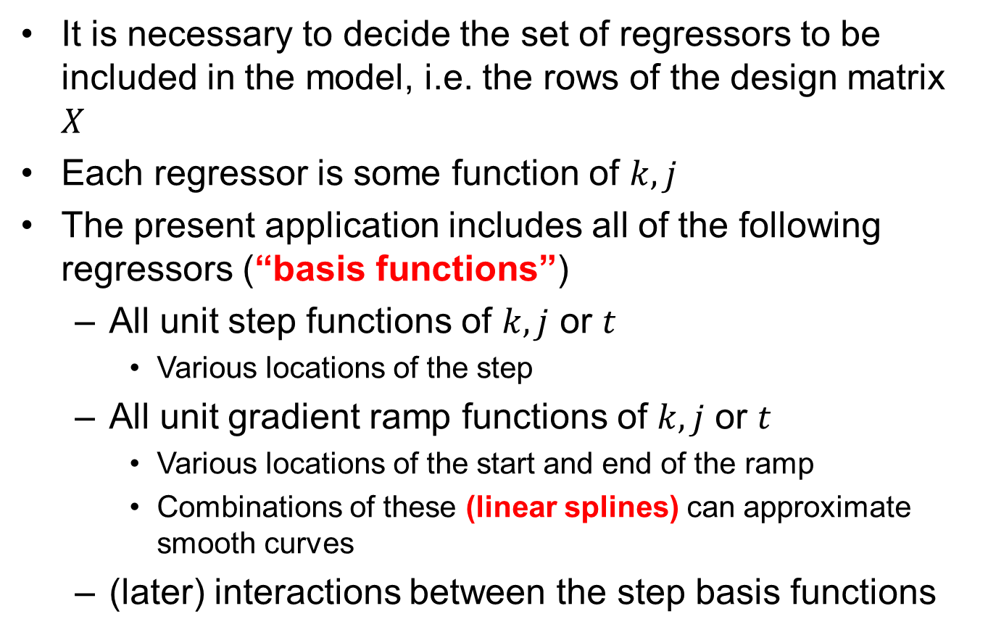
Loss reserving framework and notation (2)
It is necessary to decide the set of regressors to be included in the model, i.e. the rows of the design matrix $X$
Each regressor is some function of $k,j$
The present application includes all of the following regressors (“basis functions”)
  All unit step functions of $k,j$ or $t$
    Various locations of the step
  All unit gradient ramp functions of $k,j$ or $t$
    Various locations of the start and end of the ramp
    Combinations of these (linear splines) can approximate smooth curves
  (later) interactions between the step basis functions

Slide 13
Overview
Motivation
Regularized regression
  In general
  The lasso
Loss reserving framework and notation
Application of lasso to loss reserving
Test on simulated data
  Data set
  Results
Further testing and development
Conclusion

Slide 14
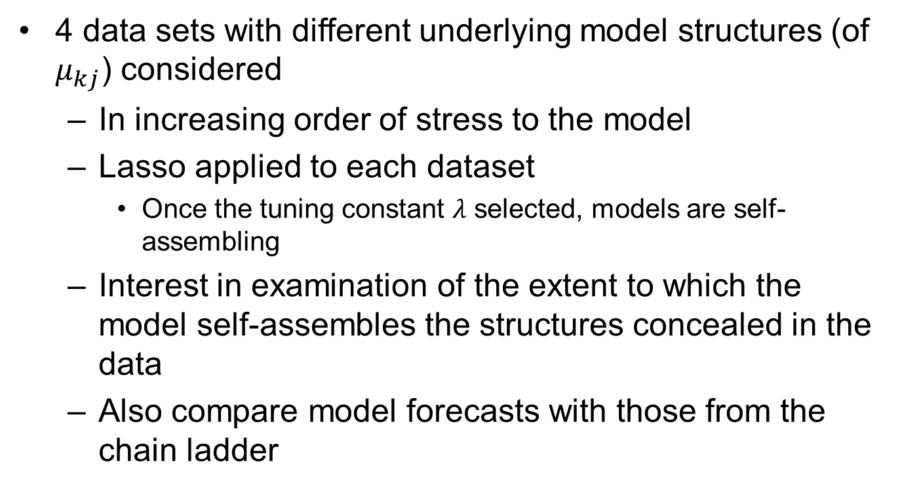
Application of lasso to loss reserving
4 data sets with different underlying model structures (of $μ_{kj}$) considered
  In increasing order of stress to the model
  Lasso applied to each dataset
    Once the tuning constant $λ$ selected, models are self-assembling
  Interest in examination of the extent to which the model self-assembles the structures concealed in the data
  Also compare model forecasts with those from the chain ladder

Slide 15
Overview
Motivation
Regularized regression
  In general
  The lasso
Loss reserving framework and notation
Application of lasso to loss reserving
Test on simulated data
  Data set
  Results
Further testing and development
Conclusion

Slide 16
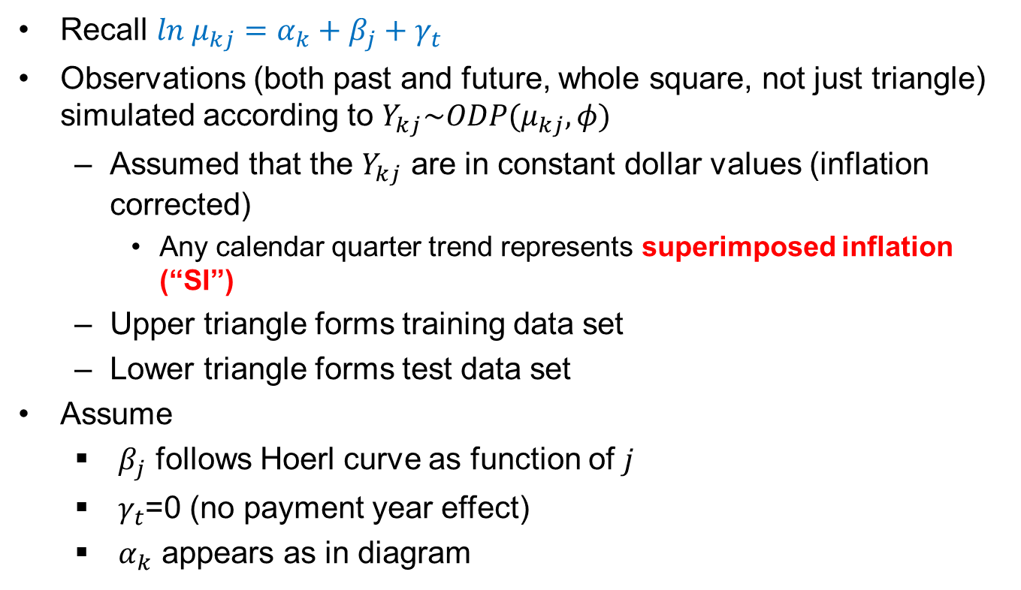
Data set 1: set-up
Recall ${ln μ}_{kj}=α_{k}+β_{j}+γ_{t}$
Observations (both past and future, whole square, not just triangle) simulated according to $Y_{kj}\sim ODP(μ_{kj},φ)$
  Assumed that the $Y_{kj}$ are in constant dollar values (inflation corrected)
    Any calendar quarter trend represents superimposed inflation (“SI”)
  Upper triangle forms training data set
  Lower triangle forms test data set
Assume
  $β_{j}$ follows Hoerl curve as function of $j$
  $γ_{t}$=0 (no payment year effect)
  $α_{k}$ appears as in diagram

Slide 17
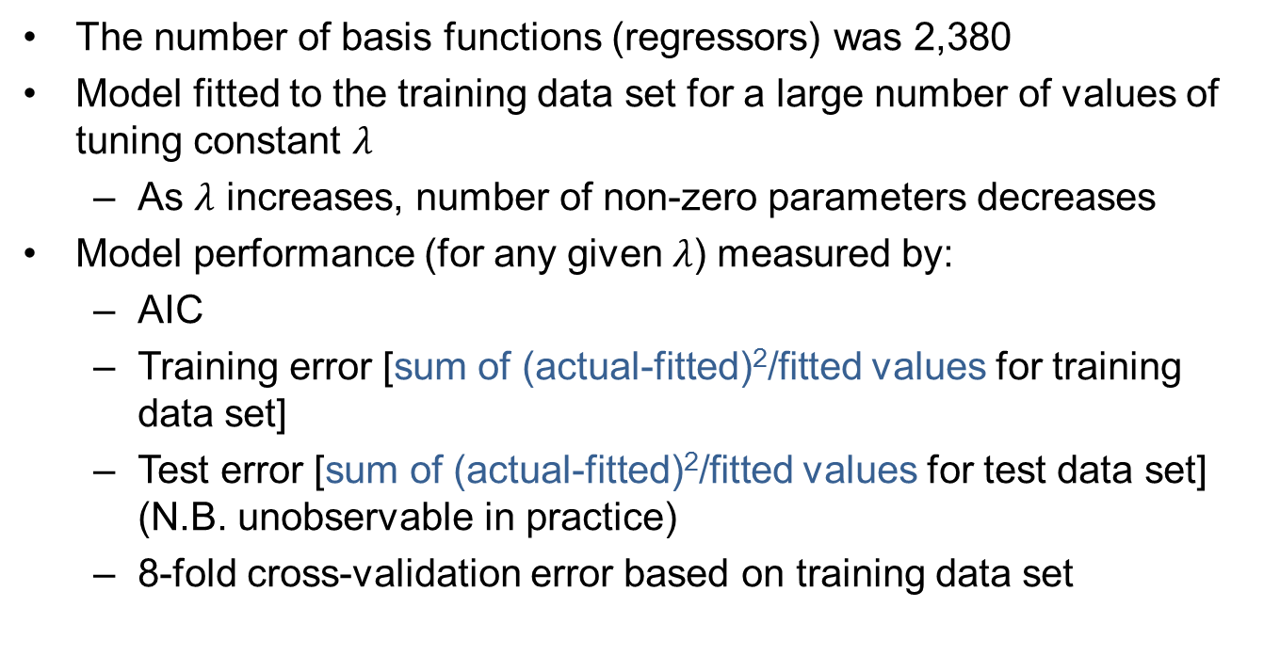
Data set 1: model selection
The number of basis functions (regressors) was 2,380
Model fitted to the training data set for a large number of values of tuning constant $λ$
  As $λ$ increases, number of non-zero parameters decreases
Model performance (for any given $λ$) measured by:
  AIC
  Training error [sum of (actual-fitted)²/fitted values for training data set]
  Test error [sum of (actual-fitted)²/fitted values for test data set] (N.B. unobservable in practice)
  8-fold cross-validation error based on training data set

Slide 18
Data set 1: model selection (cont’d)
Model selected to minimize CV error
  Other approaches are possible to reduce model complexity
Selected model contains 152 non-zero parameters

Slide 19
Data set 1: results
AQ tracking
Tracking appears reasonable
DQ tracking

Slide 20
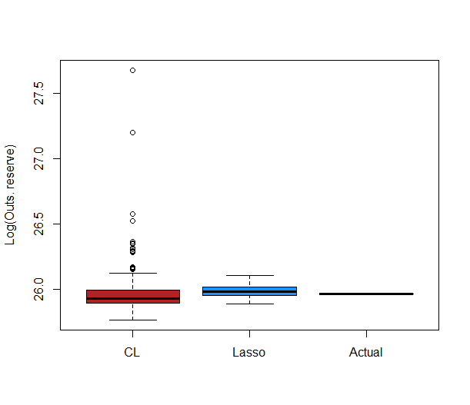
Data set 1: results (cont’d)
Loss reserve by AQ
Lasso forecast appears satisfactory
Distribution of total loss reserve
Lasso forecast tighter than chain ladder

Slide 21
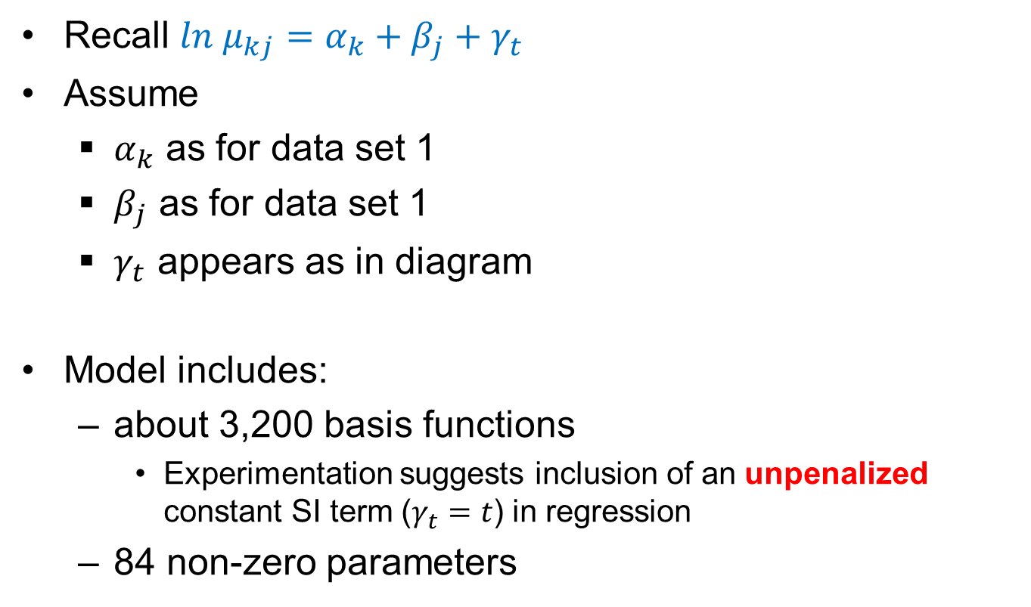
Data set 2: set-up and model selection
Recall ${ln μ}_{kj}=α_{k}+β_{j}+γ_{t}$
Assume
  $α_{k}$ as for data set 1
  $β_{j}$ as for data set 1
  $γ_{t}$ appears as in diagram
Model includes:
  about 3,200 basis functions
    Experimentation suggests inclusion of an unpenalized constant SI term ($γ_{t}=t$) in regression
  84 non-zero parameters

Slide 22
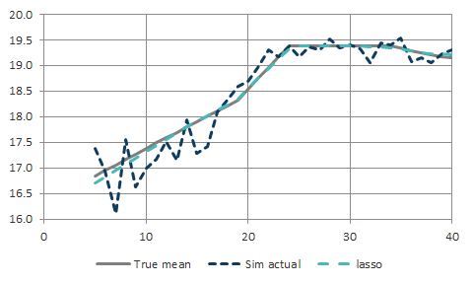
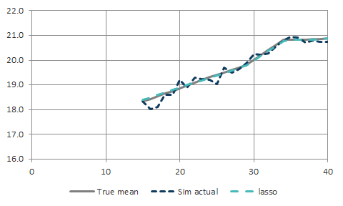
Data set 2: results
CQ tracking : at DQ 5
Tracking again appears reasonable
CQ tracking : at DQ 15

Slide 23
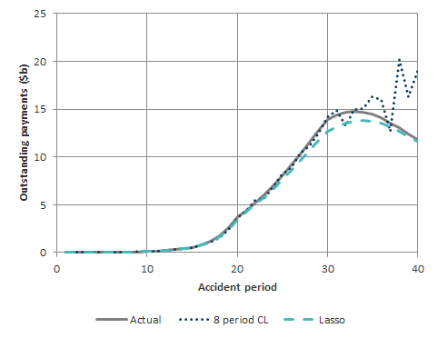
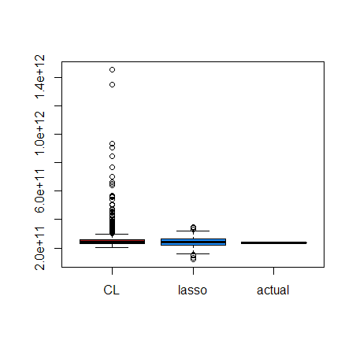
Data set 2: results (cont’d)
Loss reserve by AQ
Chain ladder now based on last 8 calendar quarters
Lasso CQ trends stopped at last diagonal
  Hence lasso biased downward relative to CL
Total loss reserve
Chain ladder highly volatile

Slide 24

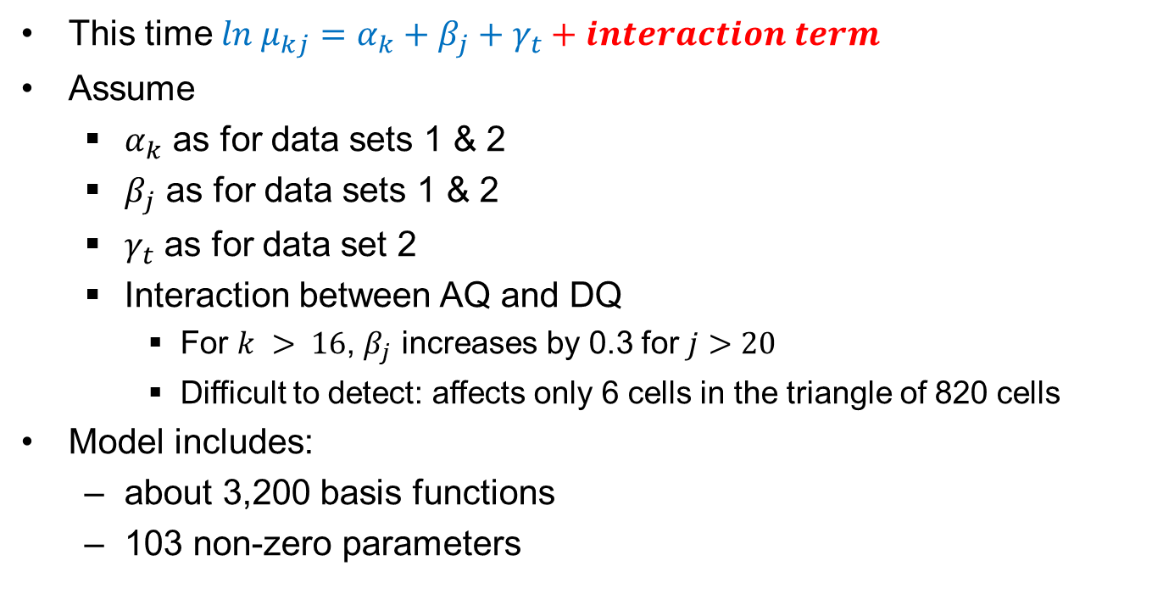

Data set 3: set-up and model selection
$$j>20$$
This time ${ln μ}_{kj}=α_{k}+β_{j}+γ_{t}+interaction term$
Assume
  $α_{k}$ as for data sets 1 & 2
  $β_{j}$ as for data sets 1 & 2
  $γ_{t}$ as for data set 2
  Interaction between AQ and DQ
    For $k > 16$, $β_{j}$ increases by 0.3 for $j>20$
    Difficult to detect: affects only 6 cells in the triangle of 820 cells
Model includes:
  about 3,200 basis functions
  103 non-zero parameters
$$k>16$$

Slide 25
Data set 3: results
DQ tracking at AQ 25
DQ tracking surprisingly accurate
AQ tracking at DQ 25
Though under-estimation of tail at higher AQs

Slide 26
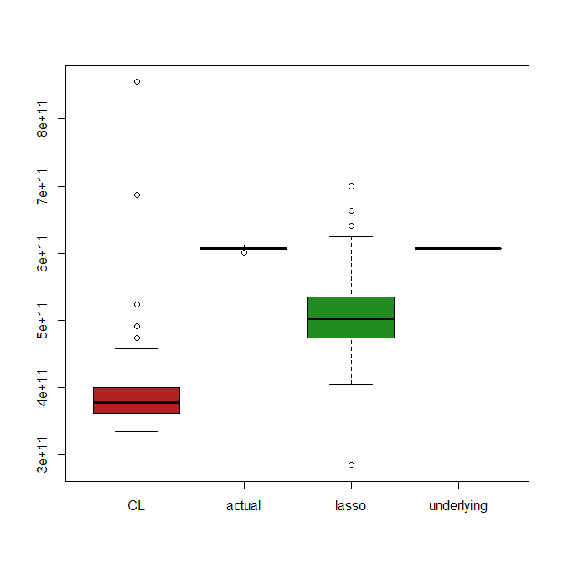
Data set 3: results (cont’d)
Loss reserve by AQ
Chain ladder now based on last 8 calendar quarters
CL and lasso both under-estimate
  But CL under-estimation greater
Total loss reserve
Chain ladder highly volatile

Slide 27
Data set 3: results (cont’d)
The AQxDQ interaction has been penalized like all other regressors
In practice, one might be able to anticipate the change
  e.g. a legislated benefit change, taking effect in AQ 17
In this case, one could apply no penalty to the interaction
Loss reserve by AQ
  Interaction unanticipated
  Interaction anticipated

Slide 28
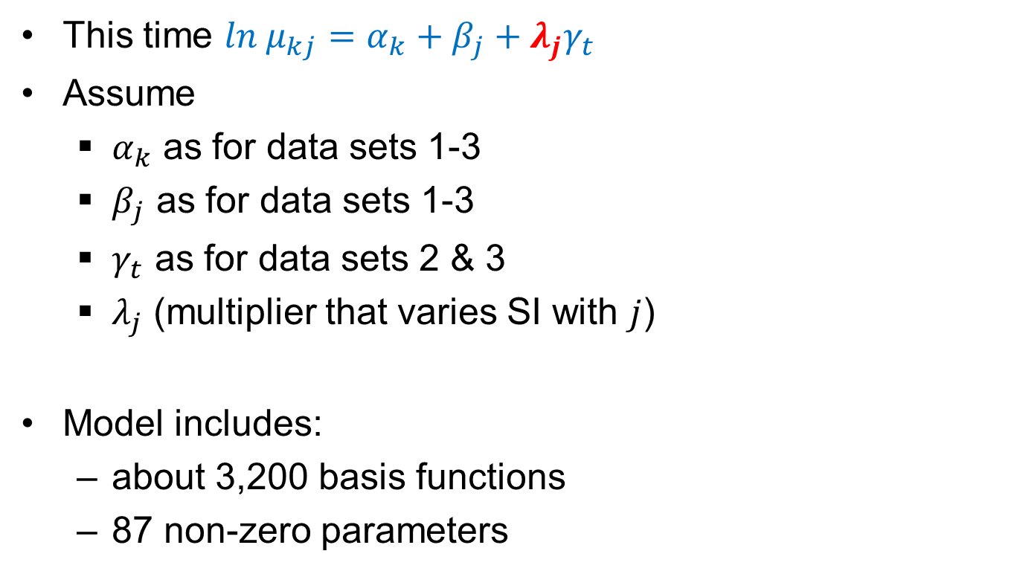
Data set 4: set-up and model selection
This time ${ln μ}_{kj}=α_{k}+β_{j}+λ_{j}γ_{t}$
Assume
  $α_{k}$ as for data sets 1-3
  $β_{j}$ as for data sets 1-3
  $γ_{t}$ as for data sets 2 & 3
  $λ_{j}$ (multiplier that varies SI with $j$)
Model includes:
  about 3,200 basis functions
  87 non-zero parameters
DQ
40

Slide 29
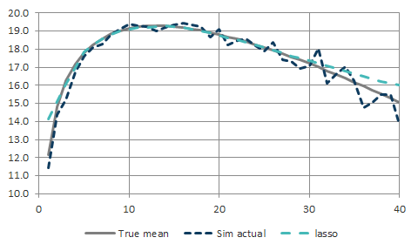
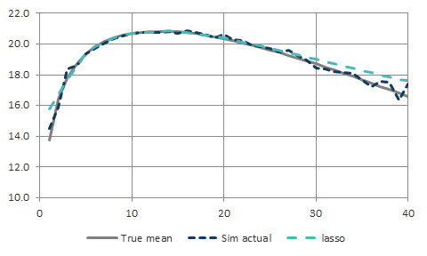
Data set 4: results
DQ tracking at AQ 10
DQ tracking at AQ 25

Slide 30
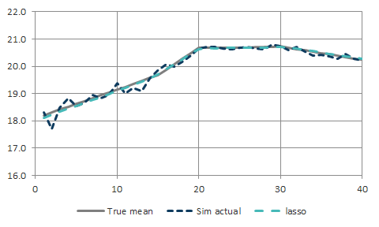
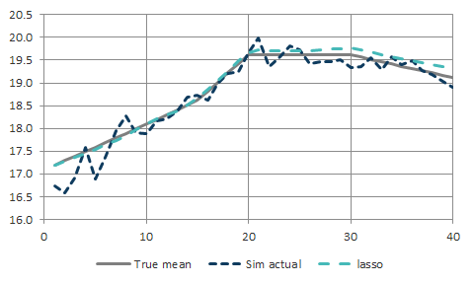
Data set 4: results (cont’d)
AQ tracking at DQ 10
AQ tracking at DQ 25

Slide 31
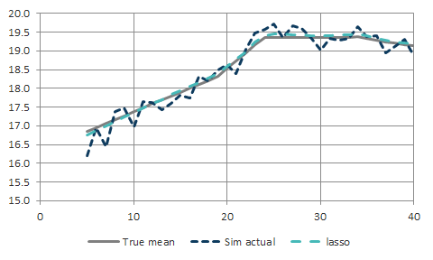
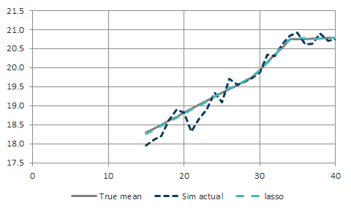
Data set 4: results (cont’d)
CQ tracking at DQ 5
CQ tracking at DQ 15

Slide 32
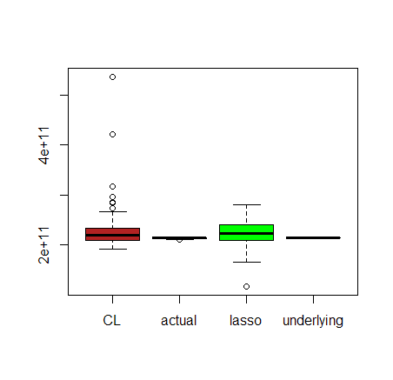
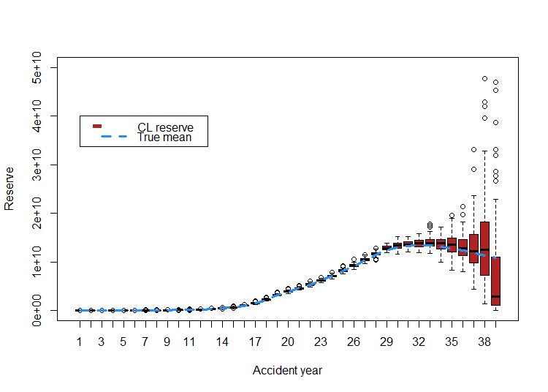
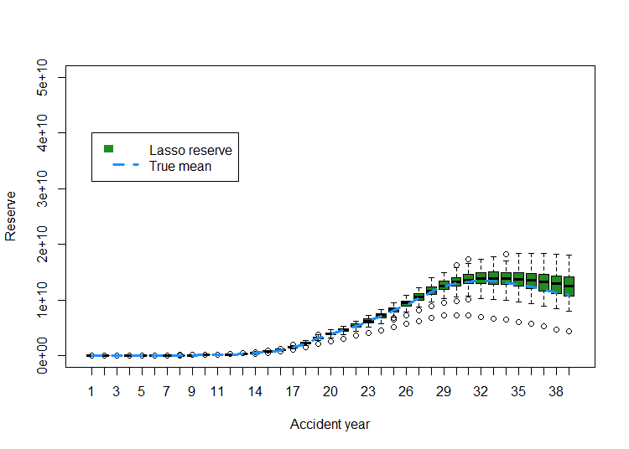
Data set 4: results (cont’d)
Total loss reserve
Chain ladder comparable with lasso but with some outlying forecasts
Loss reserve by AQ
Lasso more efficient predictor of individual accident quarters

Slide 33
Overview
Motivation
Regularized regression
  In general
  The lasso
Loss reserving framework and notation
Application of lasso to loss reserving
Test on simulated data
  Data set
  Results
Further testing and development
Conclusion

Slide 34
Further testing and development
Examination of additional scenarios
  Particularly those likely to stress the chain ladder
Different basis functions
  e.g. Hoerl curve basis functions for DQ effects
Consideration of future SI
  How well adapted to extrapolation is the lasso?
Robustification
Multi-line reserving (with dependencies)
Adaptive reserving
  How might the lasso be adapted as a dynamic model?

Slide 35
Overview
Motivation
Regularized regression
  In general
  The lasso
Loss reserving framework and notation
Application of lasso to loss reserving
Test on simulated data
  Data set
  Results
Further testing and development
Conclusion

Slide 36
Conclusion
The lasso appears promising as a platform for self-assembling models
  The model calibration procedure follows a routine and is relatively quick
    Perhaps 30 minutes for routine calibration and examination of diagnostics
    Perhaps an hour if one or two ad hoc changes require formulation and implementation
      e.g. superimposed inflation, legislative change
The lasso appears to track eccentric features of the data reasonably well
  Including in scenarios where the chain ladder has little hope of an accurate forecast
Some further experimentation required before full confidence can be invested in it as an automated procedure

Slide 37
References
McGuire, G. 2007. “Individual Claim Modelling of CTP Data.” Institute of Actuaries of Australia XIth Accident Compensation Seminar, Melbourne, Australia. http://actuaries.asn.au/Library/6.a_ACS07_paper_McGuire_Individual%20claim%20modellingof%20CTP%20data.pdf
Taylor, G., and G. McGuire. 2004. “Loss Reserving with GLMs: A Case Study.” Casualty Actuarial Society 2004 Discussion Paper Program, pp 327-392.
Taylor, G., and G. McGuire. 2016. “Stochastic Loss Reserving Using Generalized Linear Models”. CAS Monograph Series, Number 3. Casualty Actuarial Society, Arlington VA.

Slide 38
Questions?

