Slide 1

Who knows better in an Emerging Market?
Performance of Institutions, Foreigners and Individuals.
Diego A. Agudelo
James E. Byder
Paula A. Yepes
Universidad EAFIT
Notes:
Me hacen falta referencias a la literatura. Aclarar la contribución

Slide 2
Motivation
Are all investors created equal? Or there are different roles for different types of investors?
  Who provides liquidity?
  Who incorporates information in prices?
  Who trades at lower cost ?
  Who trades with a better timing ?
  Who has the better performance?

Slide 3
Background
 | Authors | Journal | Data from | Major finding
Big Fish in Small Ponds | Grinblatt and Keloharju | JFE 2002 | Finland | Foreigners perform better
 | Huang Shiu | FM 2009 | Taiwan
 | Froot, O`Connel, Seasholes | JFE 2001 | 44 Stock markets | Foreign inflows predict returns in Emerging Markets
 | Richards | JFQA 2009 | 6 Asian markets
Home Advantage | Brennan and Cao | JF 1997 | US flows to 4 developed countries | Locals perform better
 | Hau | JF 2001 | Professional traders in German stocks
 | Dvorak | JF 2005 | Indonesia
 | Chan, Mekveld and Yang | JF 2008 | China
 | Choe, Kho and Stulz | RFS 2005 | Korea

Slide 4
Our contribution
We measure performance of locals, separating institutions from individuals (retailers). All foreigners are institutions
Provide evidence of a link between information and short term performance
Replicate the results of the previous literature in a new emerging market
We are able to conciliate some of the contradictory findings of the previous literature

Slide 5
Our main findings
Locals have better trade execution than Foreigners. Local individuals tend to be liquidity providers.
Local institutions perform better than Foreigners, who in turn outperform Local individuals
  In several Short-term performance measures
  In several Long-term performance measures
Individuals are in an information disadvantage, as shown in a MRR Bid-Ask decompositon model
Long term local institutions (e.g. pension funds) perform better in the long term than short-term ones (e.g Brokerage firms).

Slide 6
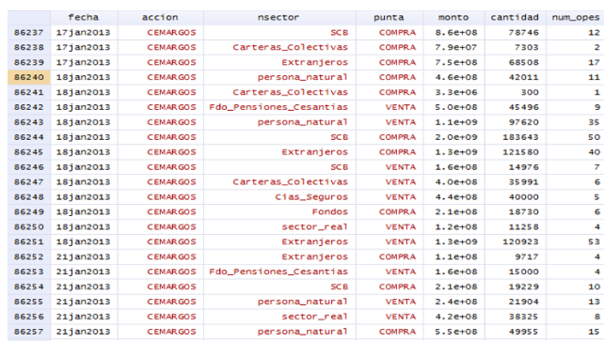
Data :
Summary of transactions by stock-day, by type of investor.
Source: Colombian Stock Exchange (BVC). Jan 2007-May 2014

Slide 7
Summary Trading Activity by type of investor
Notes:
L Institutions do 52% of the trading in value, L Individuals 35%, Foreigners 13%
In term of number of operation 34%, 9%, 57%

Slide 8
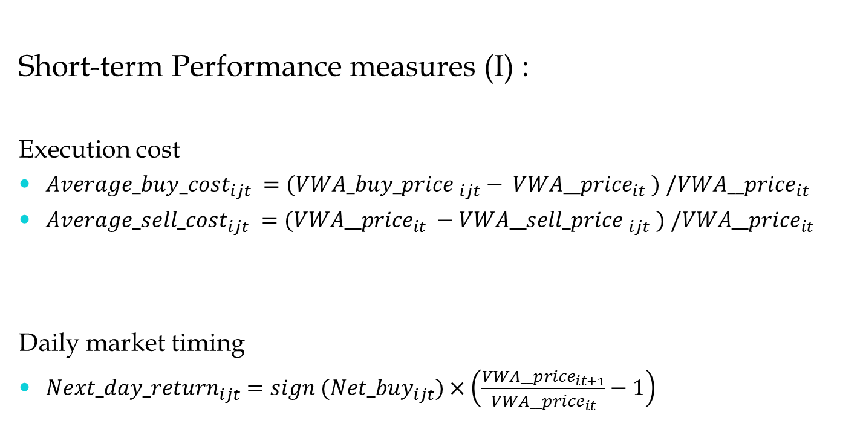
Results
Short-term Performance measures (I) :
Execution cost
${Average_buy_cost}_{ijt} =({VWA_buy_price }_{ijt}− {VWA__price}_{it} ) /{VWA__price}_{it}$
${Average_sell_cost}_{ijt} =({{VWA__price}_{it} −VWA__sell_price }_{ijt} ) /{VWA__price}_{it}$
Daily market timing
${Next_day_return}_{ijt}=sign ({Net_buy}_{ijt})×\left(\frac{{VWA__price}_{it+1}}{{VWA__price}_{it}}−1\right)$
i: stock
j: type of investor
t: day

Slide 9
Average trading cost on buys and sales
${Average_buy_cost}_{ijt} =({VWA_buy_price }_{ijt}− {VWA__price}_{it} ) /{VWA__price}_{it}$ ${Average_sell_cost}_{ijt} =({{VWA__price}_{it} −VWA__sell_price }_{ijt} ) /{VWA__price}_{it}$

Slide 10
Next-day return performace measure
$${Next_day_return}_{ijt}=sign ({Net_buy}_{ijt})×\left(\frac{{VWA__price}_{it+1}}{{VWA__price}_{it}}−1\right)$$

Slide 11
Short-term Performance measures (II) :
Daily market timing weighted by traded value
Daily market timing weighted by traded value an taking into account execution price
i: stock
j: type of investor
t: day

Slide 12
Daily performance measures

Slide 13
One-month performance of portfolio based on net buys

Slide 14
12-months performance of portfolio based on net buys

Slide 15
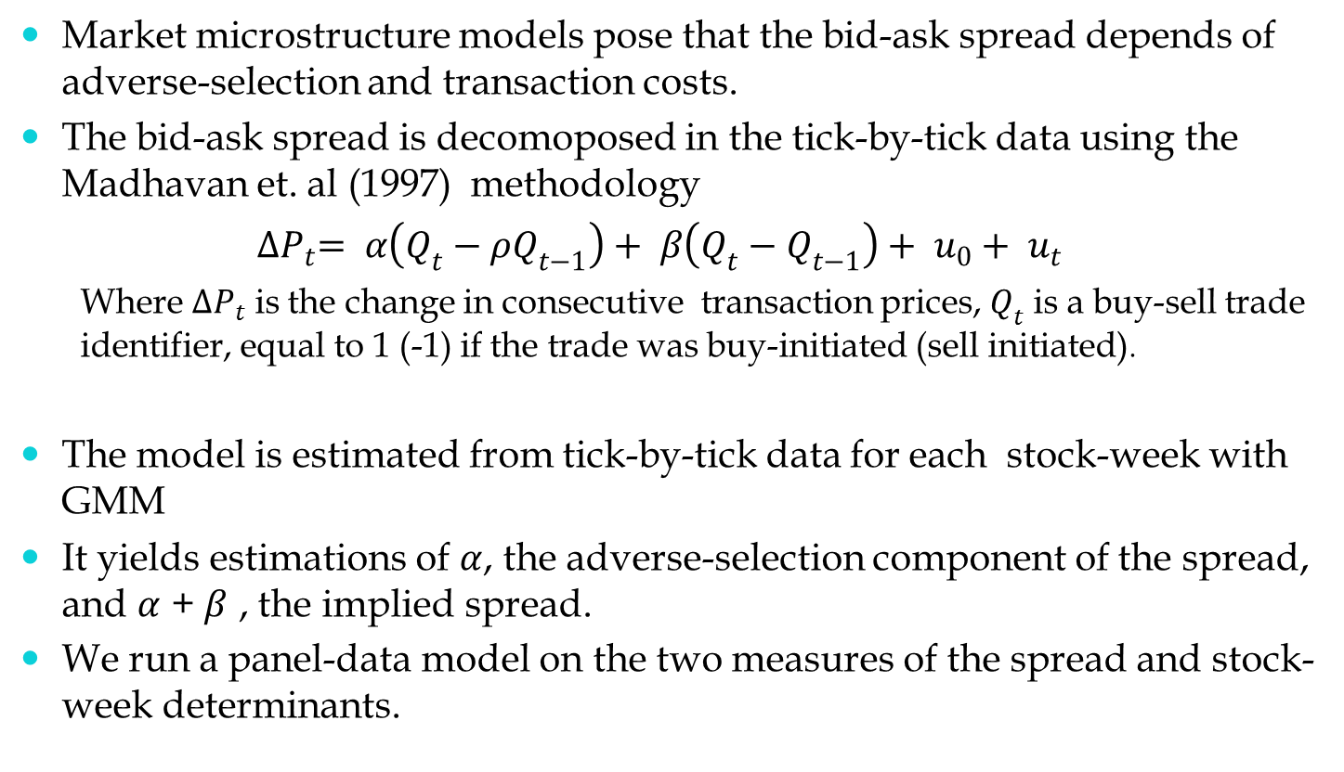
Spread decomposition to estimate information effects
Market microstructure models pose that the bid-ask spread depends of adverse-selection and transaction costs.
The bid-ask spread is decomoposed in the tick-by-tick data using the Madhavan et. al (1997) methodology
${∆P}_{t}= α\left(Q_{t}−ρQ_{t−1}\right)+ β\left(Q_{t}−Q_{t−1}\right)+ u_{0}+ u_{t}$
  Where ${∆P}_{t}$ is the change in consecutive transaction prices, $Q_{t}$ is a buy-sell trade identifier, equal to 1 (-1) if the trade was buy-initiated (sell initiated).
The model is estimated from tick-by-tick data for each stock-week with GMM
It yields estimations of $α$, the adverse-selection component of the spread, and $α$ + $β$ , the implied spread.
We run a panel-data model on the two measures of the spread and stock-week determinants.

Slide 16
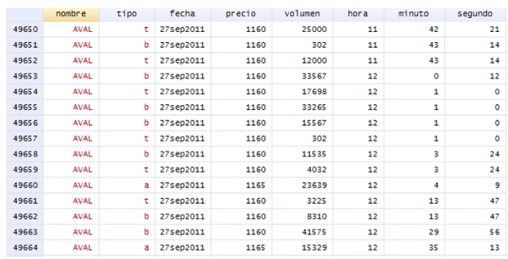
Data :
Tick-by-tick, trade and quote data.
Source: Bloomberg. Aug 2010-Aug 2012

Slide 17
Informed trading effects on the spread by different types of investors

Slide 18
Summary of Results
Institutions outperform Individuals in one-day, one-month and 12 months, and with different measures
Foreigners outperform Individuals in 1 and 12-month horizon
Local Institutional advantage in portfolios is related more to the stocks they tend to sell or avoid to buy
Some evidence of Information related advantage of Local Institutions
Who knows better: Local or Foreigners? It depends on how you pose the question?
  Institutions know better than Individuals
  Foreigners beat Local Individual
  Local Institutions have an edge over Foreign Institutions (new result)

Slide 19
Implications
Colombian Stock Exchange is not efficient to information of stocks (-0.6% monthly alfa in Q1 portfolio)
Individuals should better institutionalize their trades (e.g buying Mutual Funds, Asset Management products)
  Is just another evidence in favor of passive investment
  Not new, already proved in Taiwan (Barber, Lee, Liu and Odean, RFS 2009)
  However, Individual trading provides a useful social good: liquidity, but are they compensated?
Foreigners do seem to be better informed than Individuals.
  Another argument against capital flow barriers
Institutional Individuals beat Institutional Foreigners (a new result)

Slide 20
Who knows better in an Emerging Market? Performance of Institutions, Foreigners and Individuals.
Thanks for your interest
Diego A. Agudelo
James E. Byder
Paula A. Yepes
Universidad EAFIT – Medellín, Colombia

